Slide 1

Python Project Presentation
Welcome To Our Presentation

Slide 2
Python Project Presentation
PROJECT TITLE: FACE MASK DETECTION
Presented By
1.Tazan Rabbani (193-15-13441)
2.Tamanna Akter Sawarna(192-15-13061)
3.Tasmima Akter(192-15-13057)
4.Sk Tariqul Islam(193-15-13451)
5.Md. Mamun Sakib(191-15-12651)

Slide 3
Input Out Demo
Python Project Presentation

Slide 4

Objective
Python Project Presentation

Slide 5
Working Procedure
Train Face Mask Detector
Local face mask dataset
Train face mask classifier with Keras/ Tensorflow
Serialize face mask classifier to disk
Python Project Presentation

Slide 6
Working Procedure
Apply Face Mask Detector
Load face classifier from disk
Detect face in image / video stream
Extract each face ROI
Apply face mask classifier to each face ROI to determine “Mask” or “No Mask”
Display the result
Python Project Presentation

Slide 7

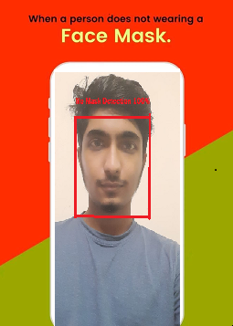
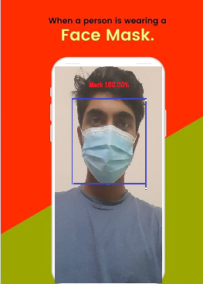
Project User Interface
Python Project Presentation

Slide 8
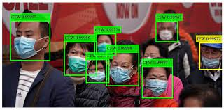
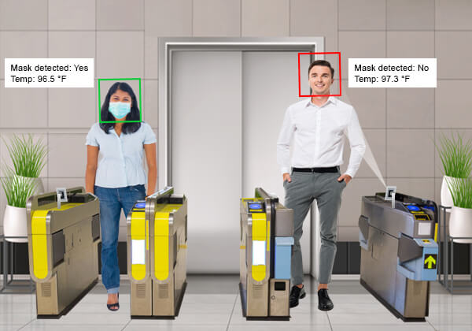
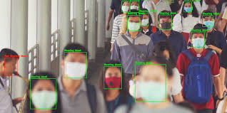

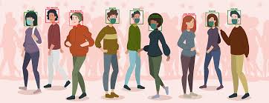
Expected Outcomes
Python Project Presentation

Slide 9
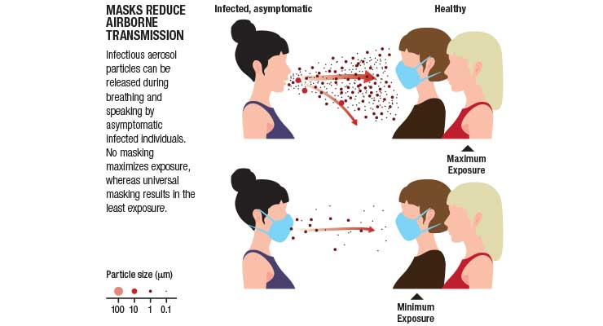

Conclusion
Python Project Presentation

Slide 10
Any Question?
Python Project Presentation

Slide 11
Thank You
Python Project Presentation

